Slide 1

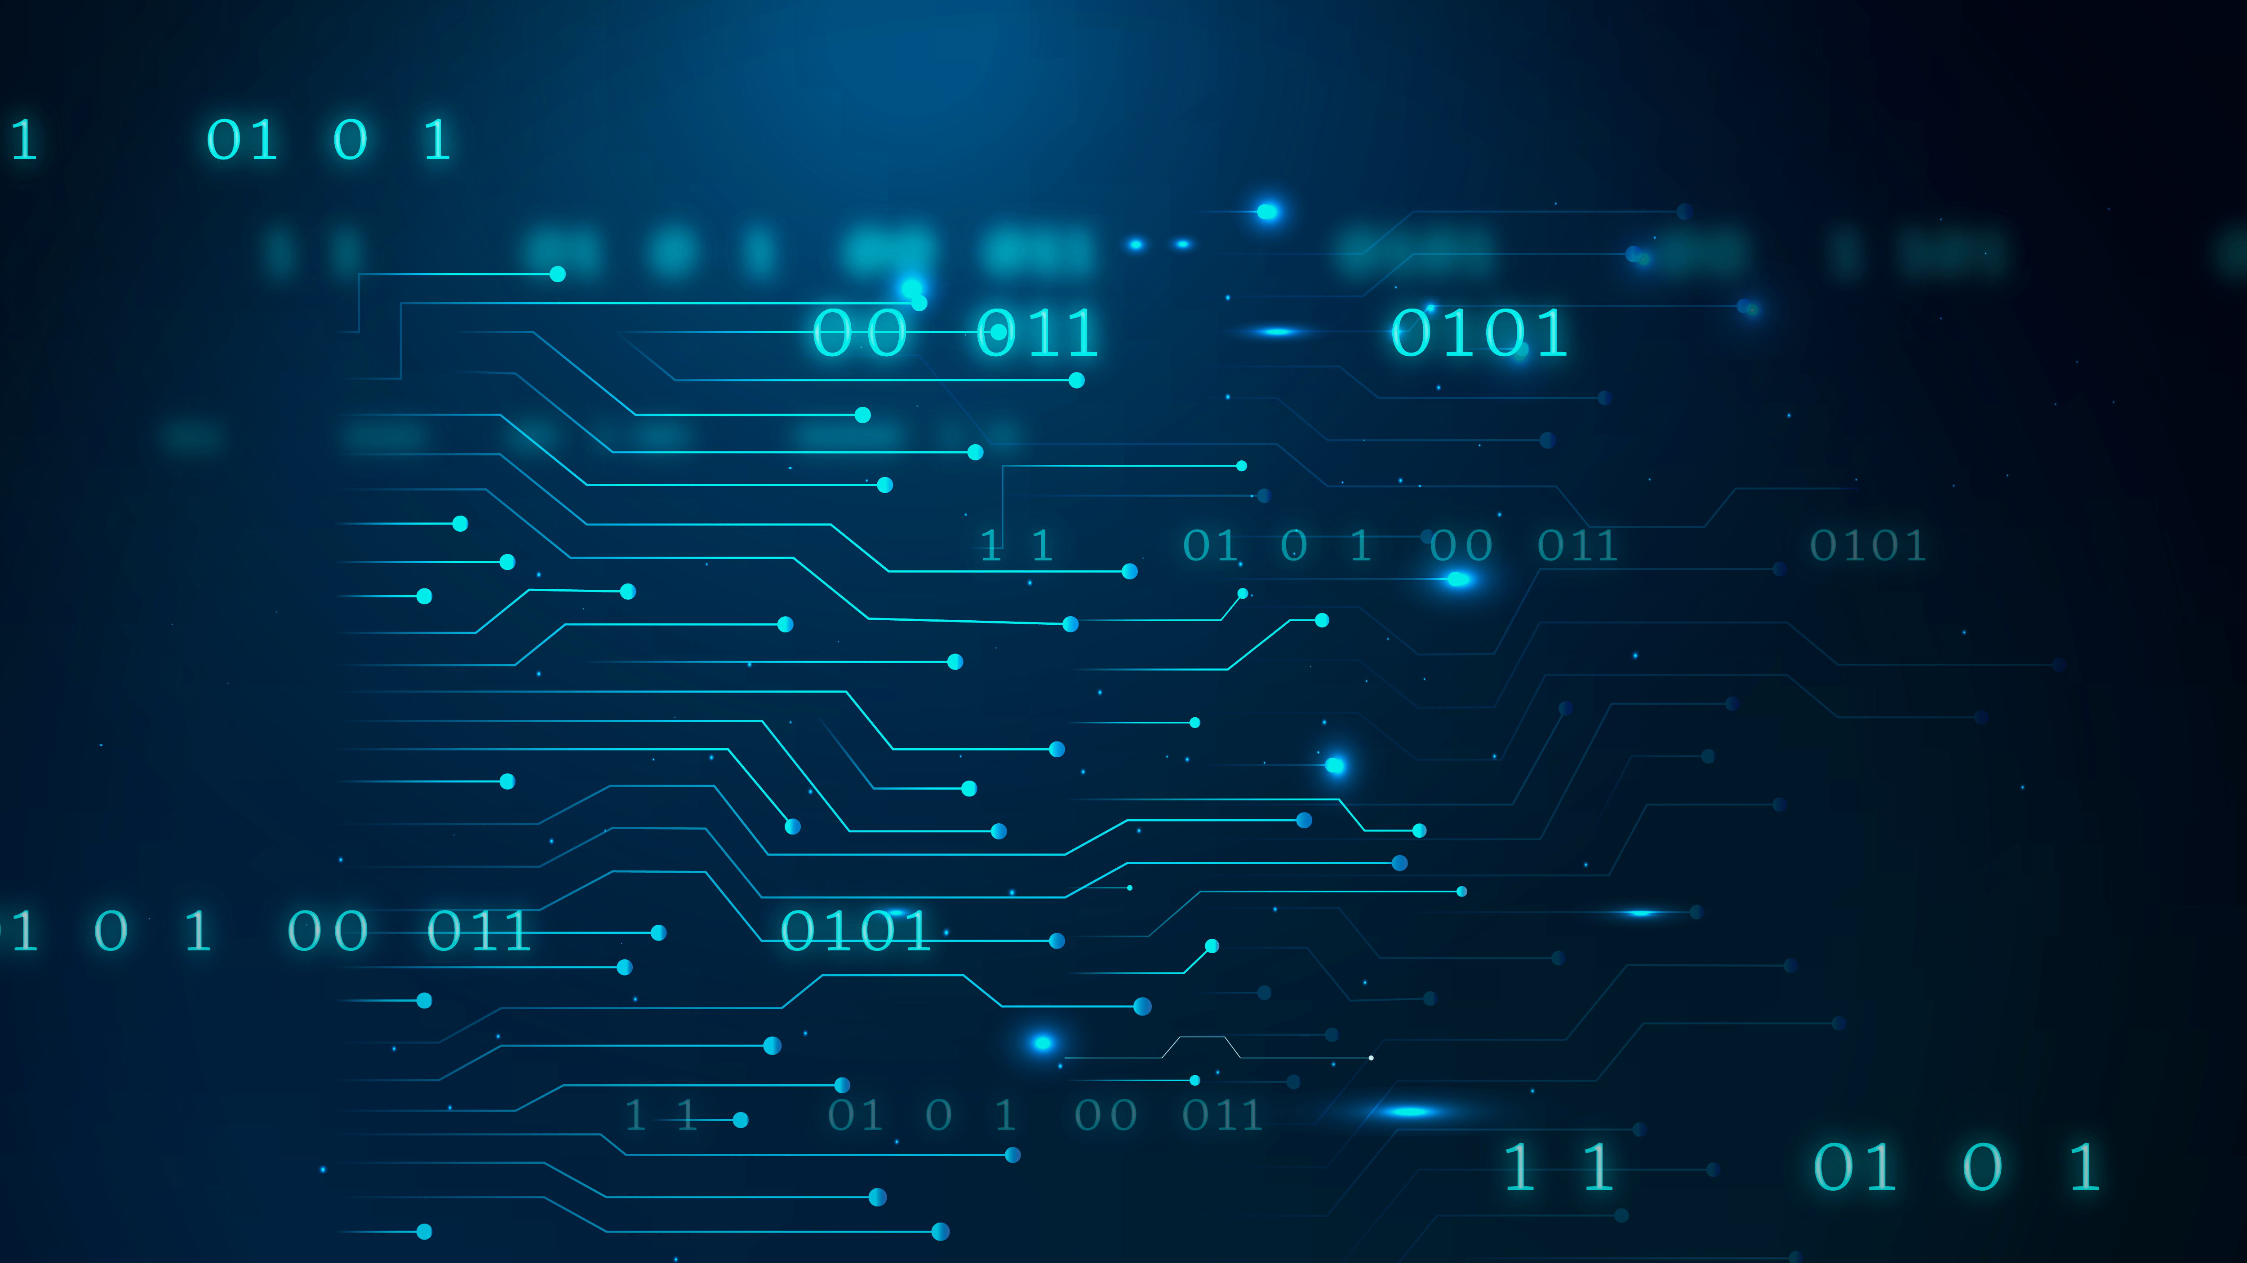
Introduction to Programming _Day_one
Abdulhafiz Ahmed

Slide 2
Why?
One of the most wanted career choices
A looked out for skill
Get’s you familiar with tech
Realize your ideas
Side hustle

Slide 3
Q: Biggest companies – Top 5
Try and list out a few

Slide 4
What’s Programming
Giving instructions to a computer, making it do what you want
Where you apply this is up to you

Slide 5
Programming languages
Bridge between the programmer and computers
There are #### programming languages created
They have rules called Syntax.

Slide 6

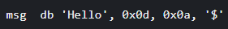
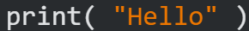
Levels of Programming language
Machine language:
Assembly language:
High-level languages:

Slide 7
Why Python
Simple syntax and keywords
Multi-purpose
Hugely popular

Slide 8
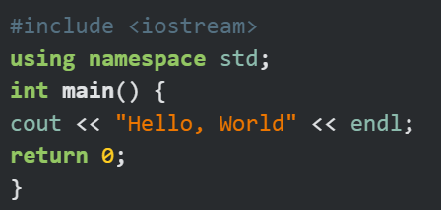
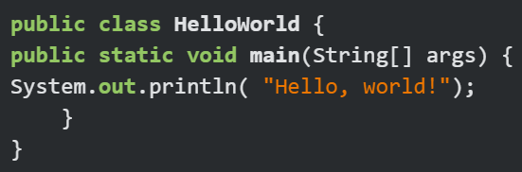
Comparison
By printing “Hello, world!”
C++ Java

Slide 9
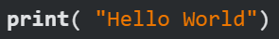
Comparison
By printing “Hello, world!”
Python

Slide 10
Python Specialties
Data science
Machine learning and AI
Web development

Slide 11
Questions
10 – 15 minutes

Slide 12
Let’s start coding
Requirements
Text editor
Python compiler

Slide 13
Let’s start coding
Requirements
Text editor
Python compiler

